Slide 1

Machine Learning Challenge – Using AI to Validate Carbon Containment in the Illinois Basin
Basem Barbary

Slide 2
AGENDA
Data Exploration
Data Preprocessing
Data Visualization
Data Modeling
Results
This challenge aims to use time series injection information and monitoring data on a carbon capture well to predict carbon capture well injection rates deltas.

Slide 3
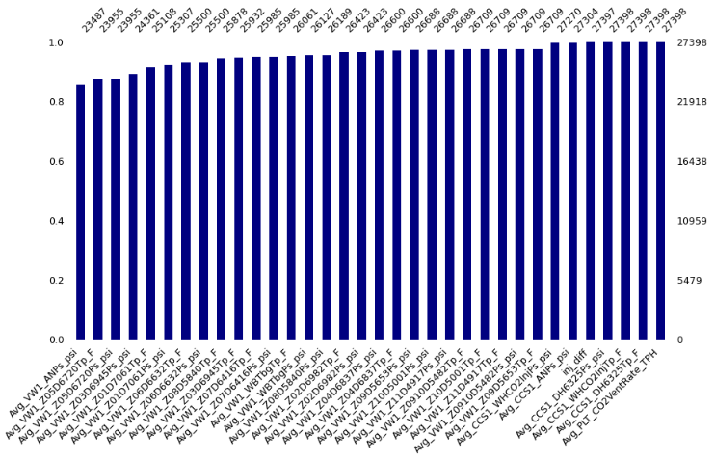
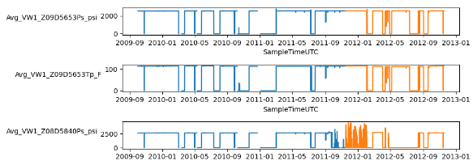
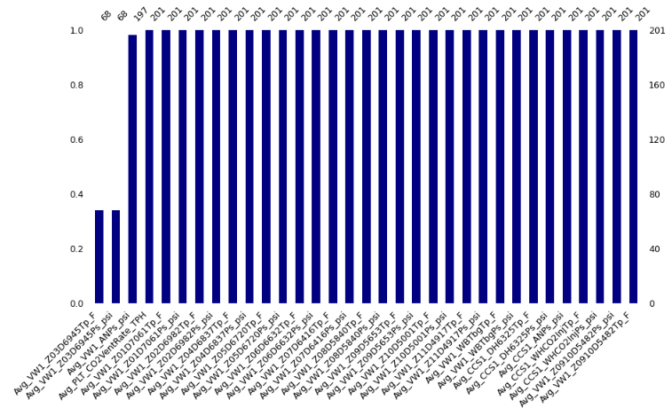
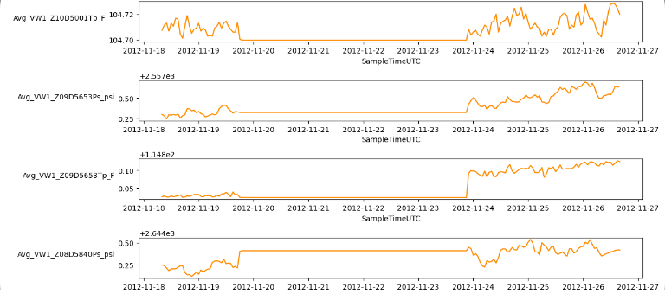
DATA EXPLORATION
Missingness Matrix: Train Set
Time Series Plots: Train Set
Train Dimensions
Rows: 27398 | Columns: 35
Monitoring at the IBDP started in 2009 which is identified as the start of the pre-injection phase and represented as the blue data in the train set plots above. Injection at IBDP started on November 17, 2011, and is presented as orange data in the plots. The train set holds data from pre-injection and injection phases of the project. The train set holds data from the injection phase which is a continuation of the data collected
Missingness Matrix: Test Set
Time Series Plots: Test Set
Test Dimensions
Rows: 201 | Columns: 34
Notes:
The data set at hand is includes timestamps, therefore, indexing ‘SampleTimeUTC’ variable is necessary. Each variable in the train and test set are plotted vs. the indexed timestamps to visualize the data points. The variables in the data set include temperature, pressure, and rate measurements. The pressure and temperature data is measured using sensors where nine zones of the Mount Simon Sandstone and two zones above the Eau Claire Shale (primary seal). Upon observing the visualizations, it is clear that the noise observed for the zone 8 pressure variable after November 17, 2011, is due to injection through the wellbore. Missing values and 0 appearances are present as seen in the visualizations. Investigating the missing values in each column beyond just the count in the dataset is important. In doing so, trends can be identified which will aid in better understanding the data set in its entirety. In the train set, ‘Avg_VW1_ANPs_psi’, ‘Avg_VW1_Z03D6945Ps_psi’, ‘Avg_VW1_Z05D6720Ps_psi’ and ‘Avg_VW1_Z05D6720Tp_F’ are missing more than 11% of their values which need to be handled accordingly. Upon further investigating the data points, it is apparent that these values are missing both at random due to 0 values continuously present before or after missing values, and systematically, due to measurement equipment sensitivity. In the test set, the variables ‘Avg_VW1_Z03D6945Ps_psi’ and ‘Avg_VW1_Z03D6945Tp_F’ are missing 67% of values. There are several outliers present in the train set found using statistical analysis. Investigating where 0 values appear and determining if they are a worthy appearance to include in the data is necessary prior to removing outliers. Upon counting the 0 appearances in the train set, every variable has many counts 0. The only variables in which 0 can accurately appear as a data point are ‘Avg_PLT_CO2VentRate_TPH’, ‘Avg_VW1_ANPs_psi’and ‘inj_diff’. Specifically, any 0 values observed for pressures and temperatures in each zone will need to be handled. In the test set, 0 values appear in ‘Avg_VW1_Z03D6945Ps_psi’ and ‘Avg_VW1_Z03D6945Tp_F’. Extracting a portion of the train dataset will reduce the presence of outliers, 0s, and noisy data in the train set at hand and eliminate the need for aggressive outlier removal, which could potentially risk the integrity of the data set.

Slide 4
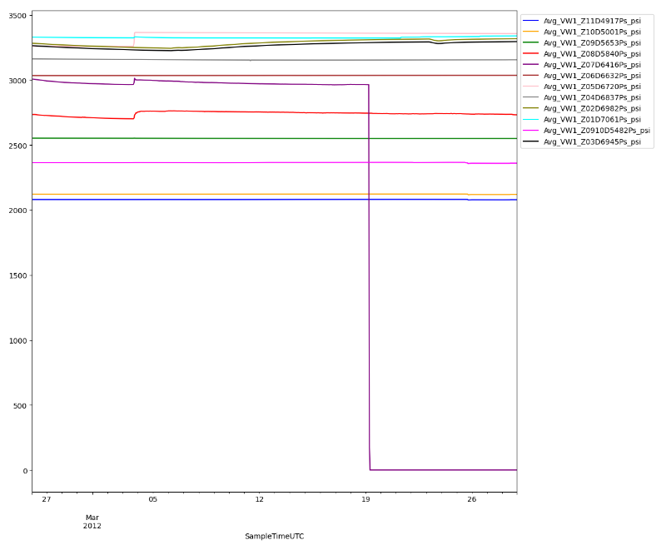
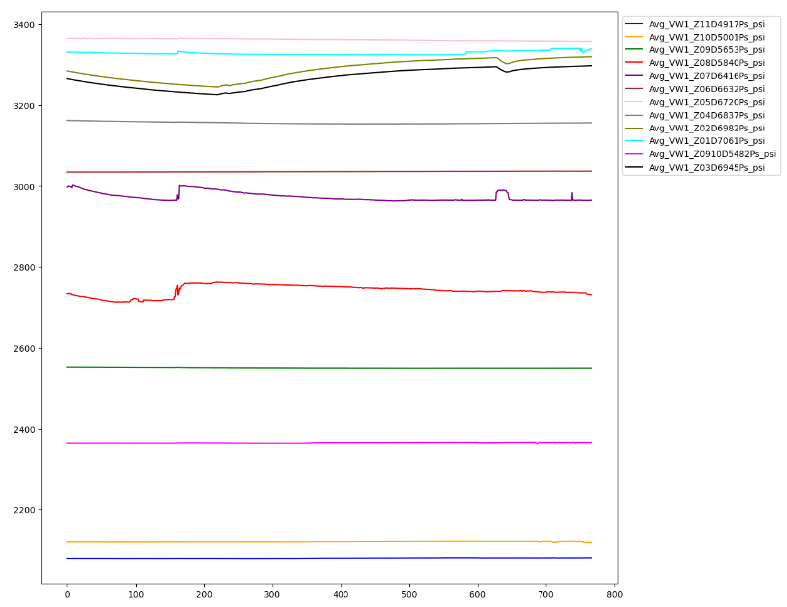
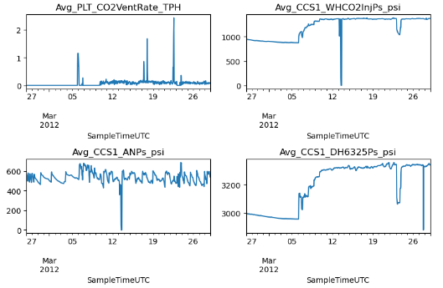
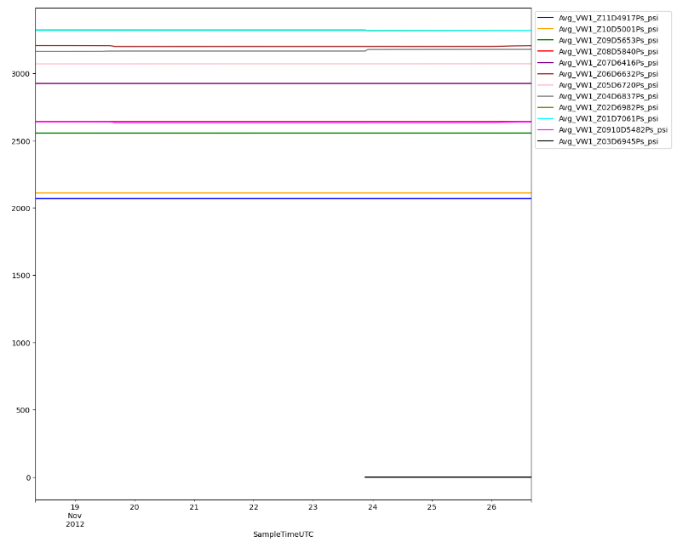
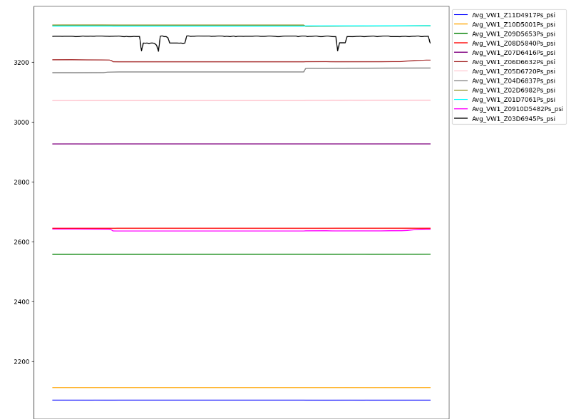
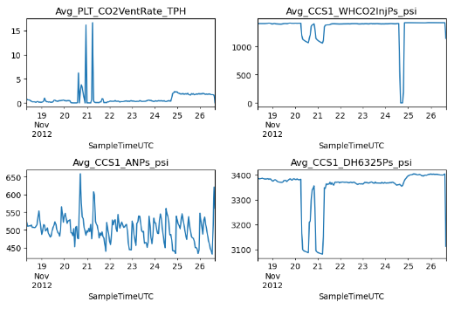
DATA PREPROCESSING
Train Dimensions
Rows: 767 | Columns: 35
KNN
IQR
Test Dimensions
Rows: 201 | Columns: 34
KNN
Notes:
There are outliers present in the train set, concluded from the statistical analysis Within the test set, the distribution is also skewed by extreme outliers. Initially, the train set is reduced in size by using a filter to exclude data prior to first day of CO2 injection into the Illinois basin . The first 3 months of injection data will also be excluded due to the presence of noisy data in Zone 8. After experimentation, a filter on the train set to include observations between ‘2012-02-26’ and ‘2012-03-29’ best resembled the distribution and trends portrayed in the test set. It is important to maintain the integrity of the train set throughout the preprocessing techniques. The train set holds 767 rows of data in the extracted time series data. Reducing the outliers in the train set with this filter will minimize the risk of introducing bias when imputing missing values. As mentioned previously, handling the presence of 0 values is important. Imputation will be used to handle missing values and inexcusable 0 appearances in the train and test set. Outlier detection methods would consider these values outliers for which handling these 0 appearances with a more aggressive approach is necessary to avoid introducing bias. In the train set, the zone pressure and temperature variables with 0 appearance is changed to NA. In the train set, the 0 appearances found in zone 3 pressure and temperature variables are also changed to NA. KNN Imputer is used to replace the missing values using the mean values of the five nearest neighbors with estimations. The imputer is fit on the train dataset and then used to impute the missing values in the train and test set. The univariate distribution is visualized for the train and test set. Outliers were observed in several variables which can affect the accuracy of the model built if not handled accordingly. IQR outlier detection method is used to handle these outliers using the first and third quartiles where the values outside the bounds imposed are detected and replaced with missing values. KNN imputer is then fit on the updated train set resulting in a cleaned dataset without removing rows of data from the time series. It is important to note that the train and test set needs to be normalized prior to modeling to give equal weight between the features.

Slide 5
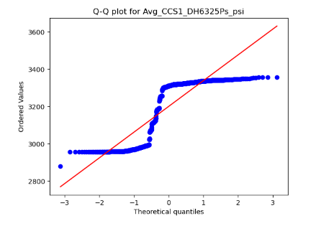
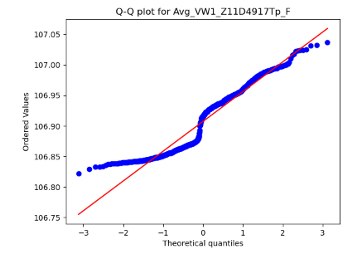
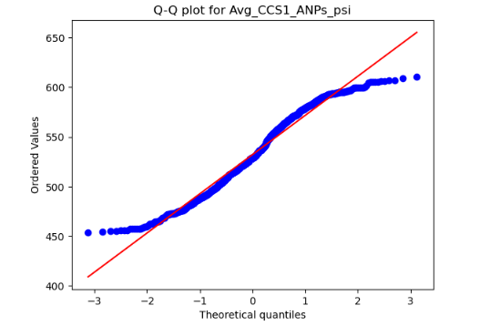
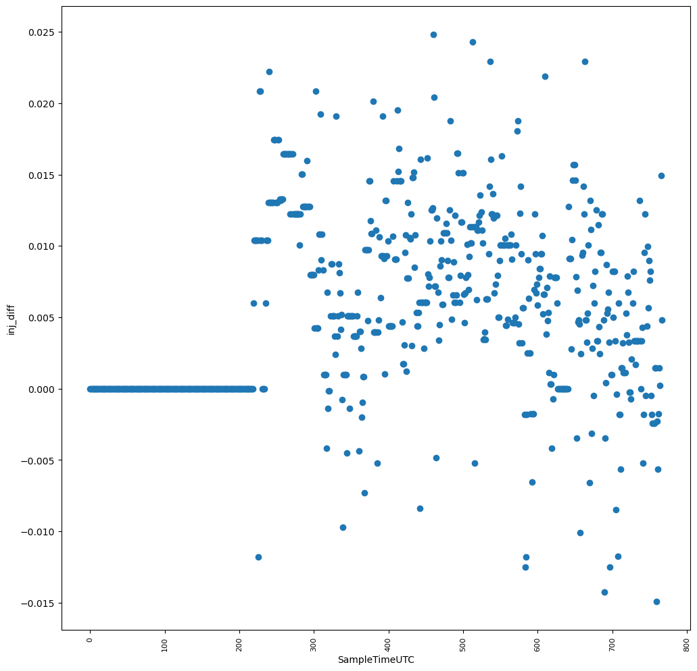
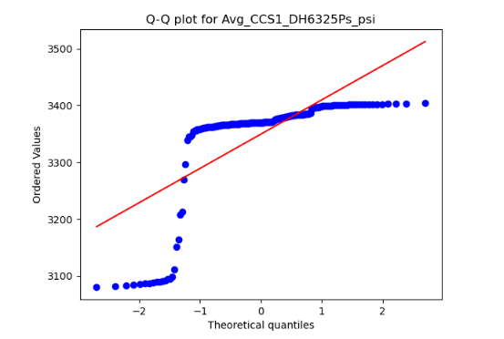
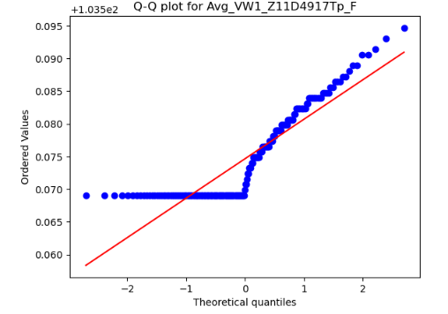
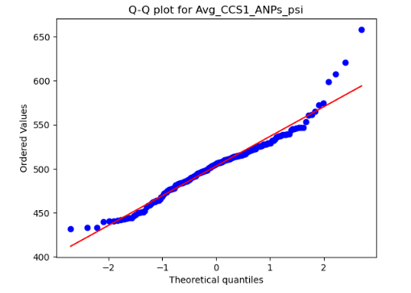
DATA VISUALIZATION
Q-Q Plots Train Set
Dependent Variable ‘inj_diff’ Scatter Plot
Q-Q Plots Test Set
Notes:
Q-Q plots, along with Histograms, were used to identify trends in the train set for each variable and then compared to the test set. The residuals for many of the variables are not normally distributed. Between the train set and test set, the trends in comparison are alike in behavior further verifying that the train set is resemblant of the test data set and can be used for predictions. This does not fully confirm that there is no evidence of overfitting or underfitting and further validation will be needed. It is determined however that training the data using a model that will allow for non-linear relationships. Visualizing ‘inj_diff’ highlights an important notion to understand within the segment of this data chosen in which constant 0 appearance is significant in determining if CO2 injection pressure changes.

Slide 6
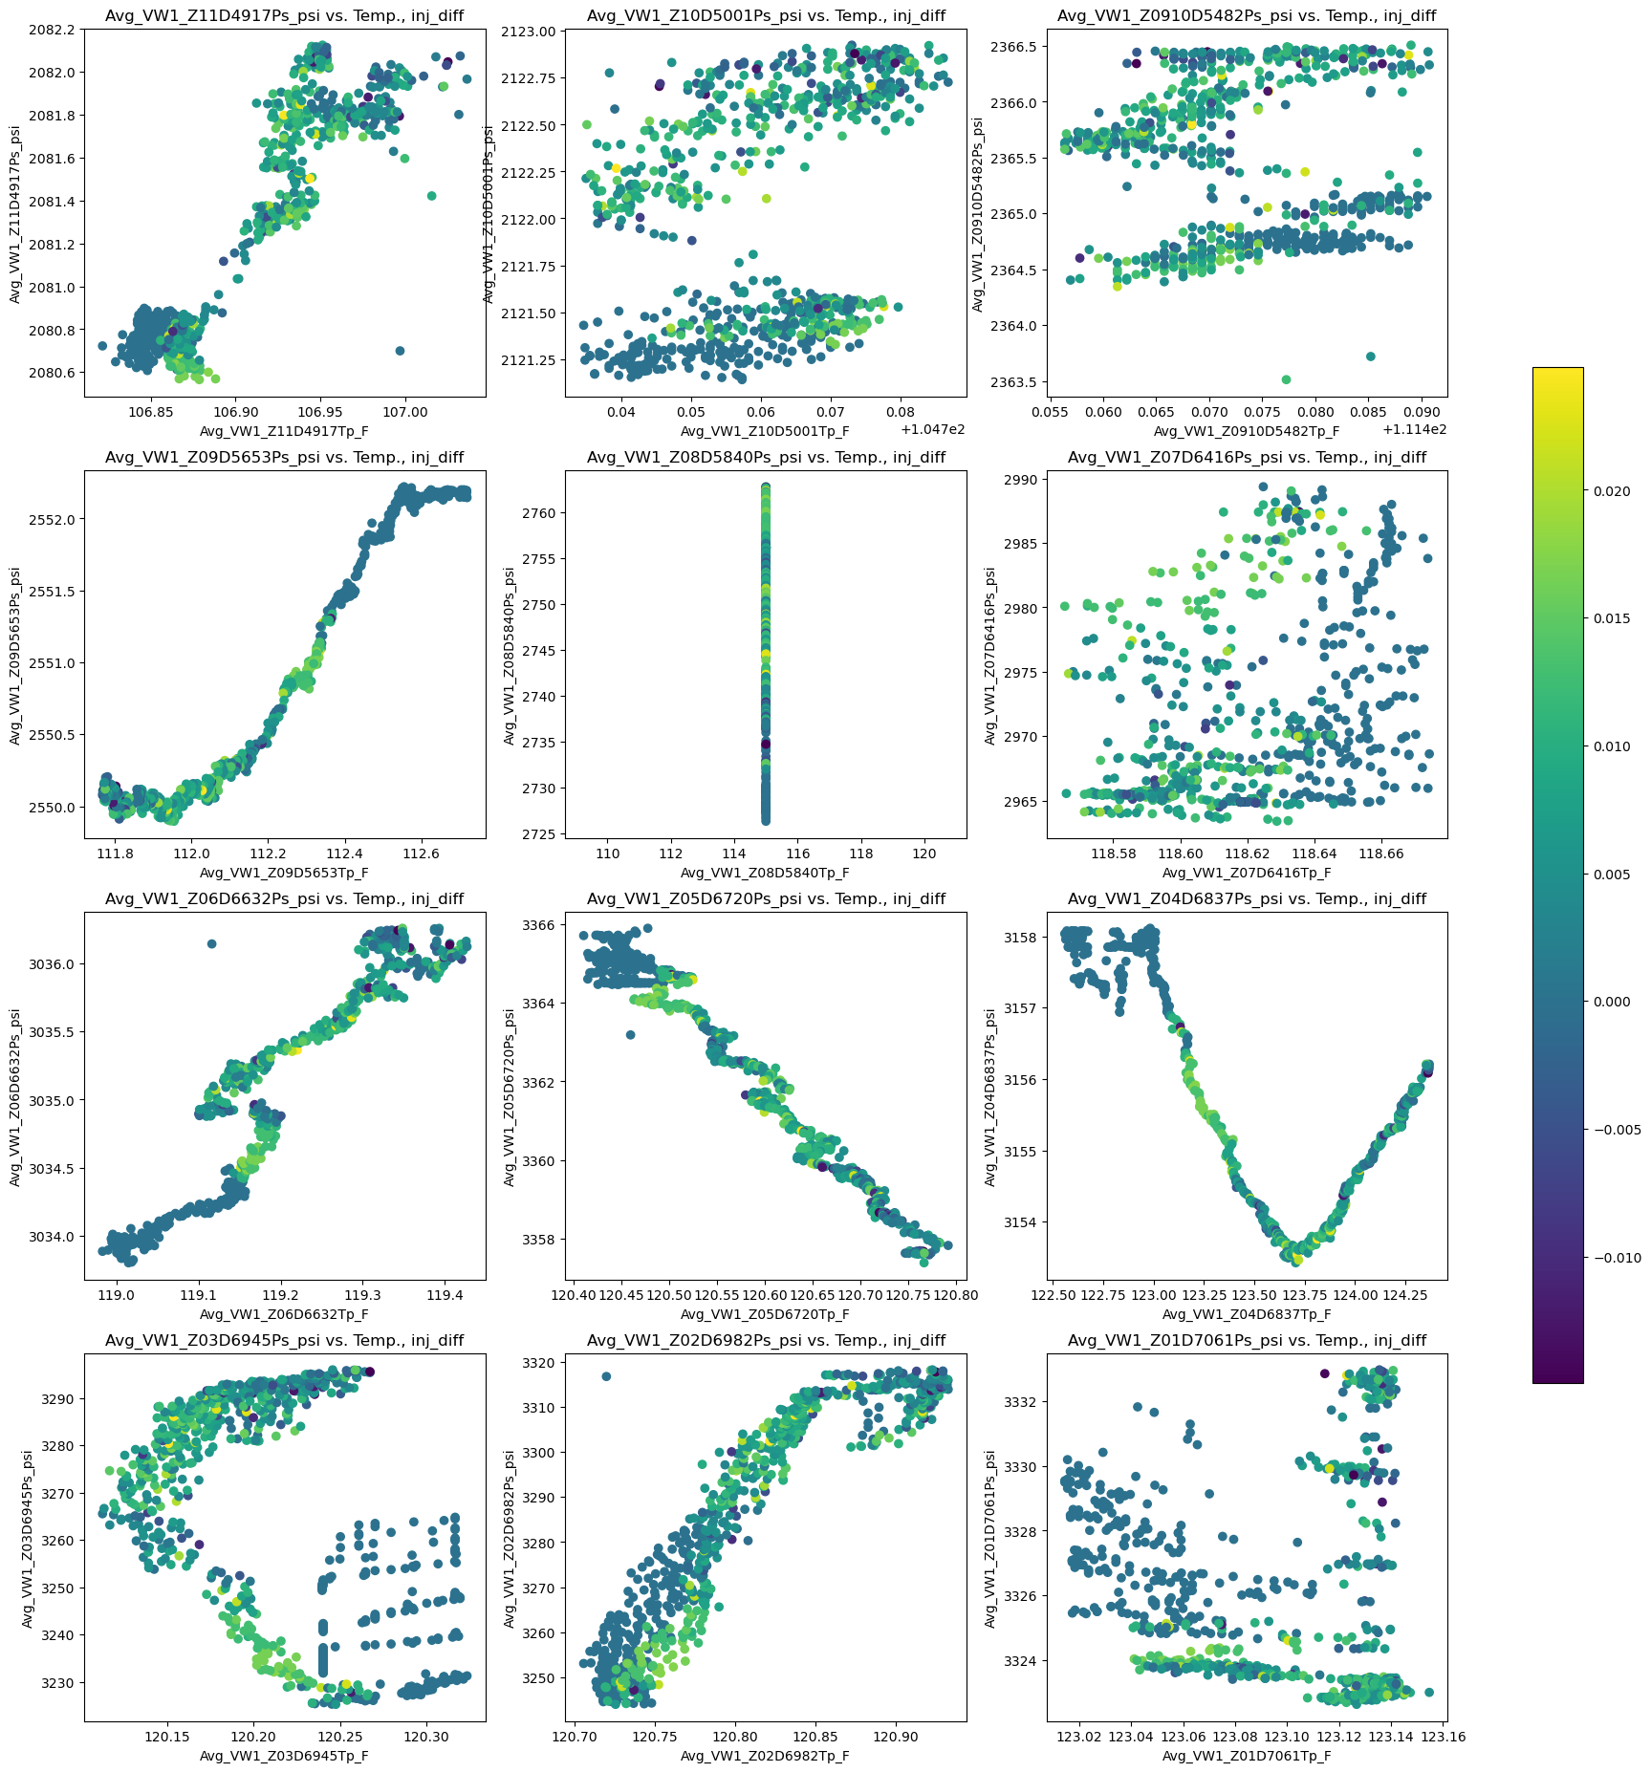
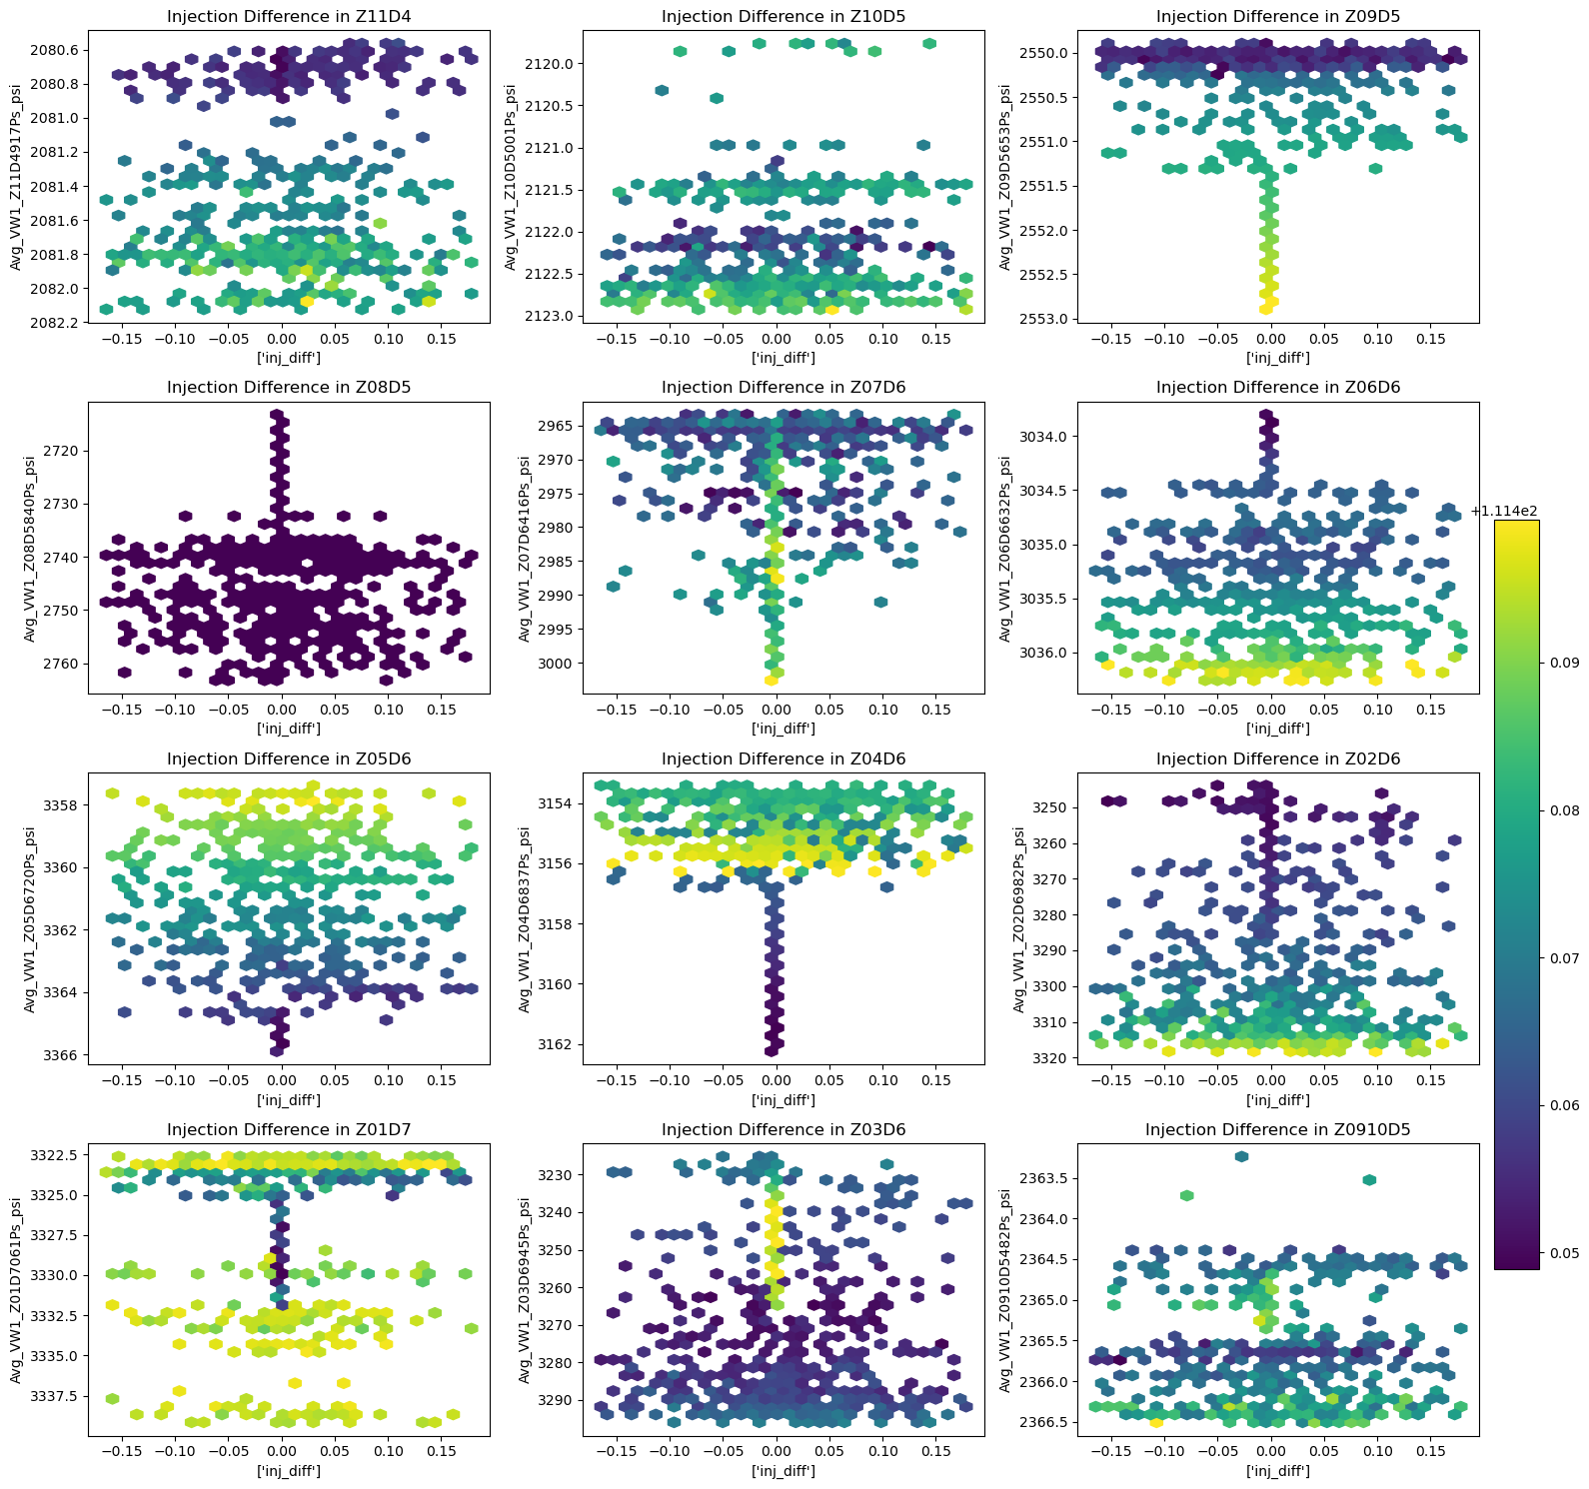
Zone Temperature - Pressure Relationship, z = ‘inj_diff’
Zone’s ‘inj_diff’ - Pressure Relationship, z = Temperature
Notes:
The collection of plots on the left are used to identify trends and relationships between the pressure and temperature variables each zone with a color gradient to help visualize the changes in ‘inj_diff’. There is clustering of points observed through the teal and green colors is obvious. The general direction and distribution of each zone’s pressure and temperature trend are important to visualize and verify against that of the test set. This ensures that the train set data will more accurately fit the model and produce predictions on the test set. The collection of plots to the right identifies how temperature in each zone impacts ‘inj_diff’ in relation to pressure in each zone. Since the train set includes observations between ‘2012-02-26’ and ‘2012-03-29’, it is important to note that these trends are after the first injection period and the CO2 migrating through the reservoir.

Slide 7
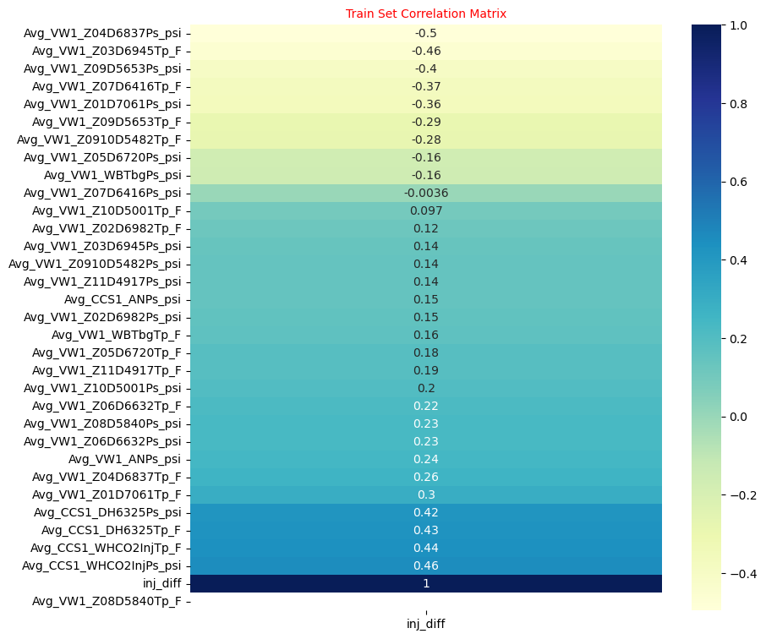
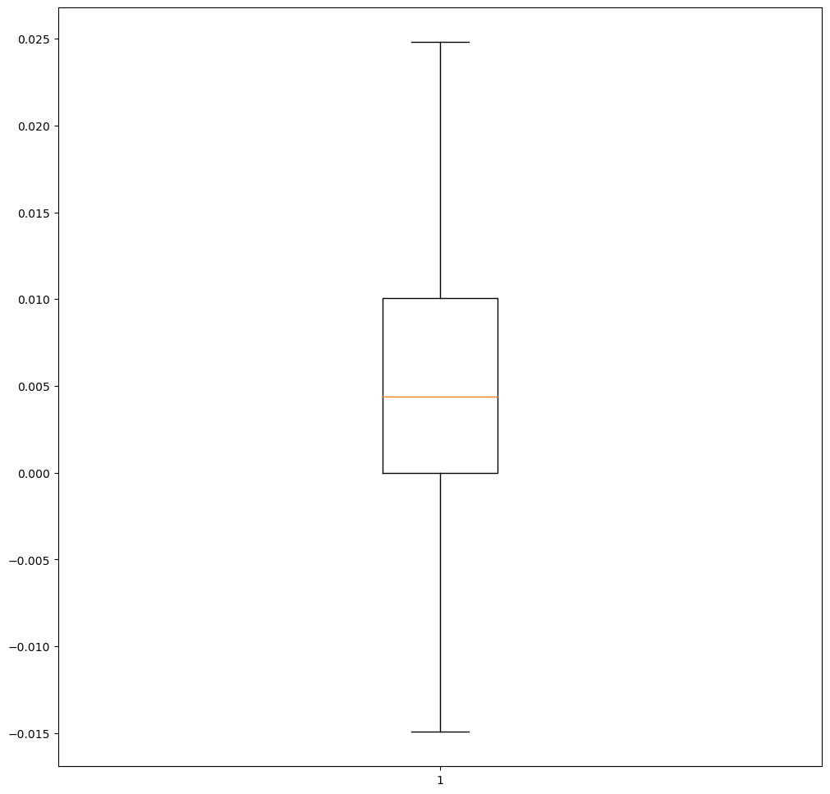
DATA MODELING
Scale by Normalizing
Machine Learning Model: Neural Network
Validation Set using Train-Test Split
Dependent Variable ‘inj_diff’ Box Plot
Notes:
In the train set, there are variables that have negative correlation to the dependent variable. The objective of this workflow is to build a regression model to predict the continuous variable, ‘inj_diff’. Neural Network modeling is selected to be used to . The train set and test set are normalized in order to scale the different magnitudes present. The neural network architecture is built using 64 neurons, 34 neurons and 1 neuron for the first, second and last layers, respectively. Rectified Linear Unit is used as the activation for the first two layers. The model is trained with a batch size of 34 and 100 epochs with 20% of the data used for validation.

Slide 8
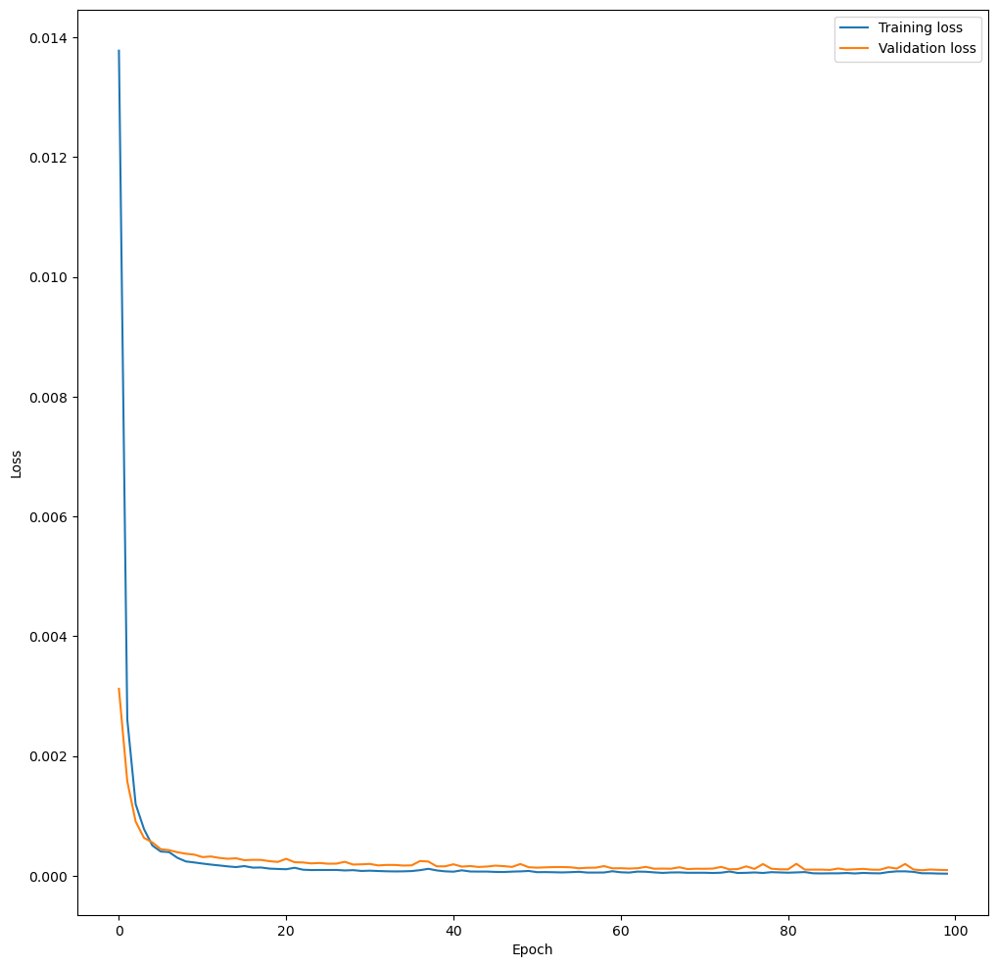
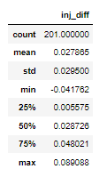
RESULTS
Training Loss and Validation Loss
Notes:
Training loss and validation loss are visualized to investigate if the model is overfitting or underfitting the data. With the parameters used to train the model, there is no evidence of overfitting or underfitting over the epochs.

Slide 9
RESOURCES
“Illinois Basin – Decatur Project (IBDP).” Netl.doe.gov, https://netl.doe.gov/coal/carbon-storage/atlas/mgsc/phase-III/ibdp#:~:text=Simon%20Sandstone%2C%20in%20Decatur%2C%20Illinois,1%2C000%20metric%20tons%20per%20day.
“Illinois Basin–Decatur Project (Chapter 19) - Geophysics and Geosequestration.” Cambridge Core, Cambridge University Press, https://www.cambridge.org/core/books/geophysics-and-geosequestration/illinois-basindecatur-project/Cn.d.81369208B12D4BF6F09CCAAFF3F6.

